Slide 1
MediCore HMS
DATABASE SYSTEMS ENGINEERING AND DISTRIBUTED BACKEND DEVELOPMENT (25CS1302E)
Hospital Management System
Project Review – II
Team Members
T. Harsha Vardhan — 2520080047
G. Anirudh — 2520080058
Course & Term
Section 13 · Team 20
Y25 · 2026–2027 · Trimester 4
Guide: _______________________ Department: Computer Science Engineering

Slide 2
MediCore HMS
OVERVIEW
Abstract
Overview: A database-driven platform that centralizes hospital operations — registration, scheduling, records, room allocation, prescriptions and billing.
Problem: Manual, paper-based hospital record-keeping causes data duplication, slow access, and billing/scheduling errors.
Proposed solution: A 3-tier web application (HTML/CSS/JS → Flask → MySQL) with role-based access for admins, doctors and receptionists.
Technologies/algorithms: Flask REST API, SQLAlchemy ORM, MySQL (3NF schema); priority scheduling and indexed lookups for records.
Current Implementation Status
Database: 9-table normalized MySQL schema — complete
Frontend: working prototype (6 modules) — complete
Backend: Flask REST API with 12 endpoints — complete
Frontend ↔ backend integration — in progress
Expected Outcome
A reliable, centralized HMS that cuts manual paperwork, speeds up scheduling/billing, and enforces role-based data access.
Hospital Management
MySQL
Flask REST API
Role-Based Access
Hospital Management System · Project Review II
1

Slide 3
MediCore HMS
THE CHALLENGE
Problem Statement
!
Existing problem
Patient, doctor, billing and room-allocation records are kept manually on paper or in disconnected spreadsheets.
●
Who is affected
Patients face delays; doctors and receptionists waste time searching records; administrators lose visibility across departments.
¥
Why it must be solved
Manual errors in billing and double-booked appointments directly affect patient care and hospital revenue.
✕
Limitations of current approach
No central database, no role-based access, no automated scheduling or indexed search across records.
Proposed problem definition: Design and implement a centralized, database-backed Hospital Management System that automates registration, scheduling, records, prescriptions and billing with role-based access.
Hospital Management System · Project Review II
2

Slide 4
MediCore HMS
WHY THIS PROJECT
Motivation
1
Why selected
2
Real-world importance
Hospitals in our region still rely heavily on manual registers — a clear, high-impact problem for applying database & backend engineering.
Efficient hospital data management directly improves patient safety, treatment speed and administrative accuracy.
3
Need for automation
4
Expected benefits
Manual scheduling and billing cannot scale with patient volume; automation removes duplication and human error.
Faster registration, conflict-free scheduling, accurate billing, and instant record retrieval for authorized staff.
Relevance: directly applicable to academic (DBMS/backend coursework), industrial (healthcare IT) and social (patient welfare) contexts.
Hospital Management System · Project Review II
3

Slide 5
MediCore HMS
GOALS
Objectives
1
Objective 1
Centralize patient, doctor, staff, room and billing records in one normalized MySQL database.
2
Objective 2
Automate appointment scheduling with priority-based ordering for emergency and critical cases.
3
Objective 3
Provide secure, role-based access so admins, doctors and receptionists see only relevant data.
4
Objective 4
Deliver a working front-end and Flask REST API that together demonstrate the full record lifecycle — register, schedule, prescribe, bill.
Hospital Management System · Project Review II
4

Slide 6
MediCore HMS
PRIOR WORK
Literature Survey
Approach | Description | Key limitation
Paper-based registers | Traditional manual record-keeping still used in many small/mid-size hospitals. | No search, high duplication, no backup
Standalone desktop DBMS tools | Single-machine applications (e.g. MS Access-based) for local record storage. | No multi-user access, poor scalability
Commercial cloud HMS suites | Full-featured vendor platforms covering billing, EHR and scheduling. | High licensing cost, limited customization
Academic HMS prototypes | Student/research projects demonstrating CRUD operations over a relational schema. | Often lack role-based access & priority scheduling
Takeaway: existing options force a trade-off between affordability, customization and proper multi-user, role-based data access — the gap this project targets.
Hospital Management System · Project Review II
5

Slide 7
MediCore HMS
WHAT'S MISSING
Research Gap
Most low-cost/academic HMS projects implement basic CRUD but skip role-based access control entirely.
Appointment modules are usually first-come-first-served only, with no priority handling for emergency/critical patients.
Billing, prescriptions and admissions are often stored as flat fields rather than normalized, independently queryable tables.
Lack of a lightweight, well-documented reference schema that a small hospital or teaching project can adopt directly.
Research Gap: Existing academic and low-cost hospital systems rarely combine a fully normalized (3NF) relational schema, priority-based appointment scheduling, and enforced role-based access in a single, deployable prototype. This project addresses that combination directly.
Hospital Management System · Project Review II
6

Slide 8
MediCore HMS
APPROACH
Proposed Methodology
Input
→
Preprocessing
→
Algorithm/Model
→
Processing
→
Output
→
Performance Eval.
Input: Forms filled by receptionists/doctors: patient details, appointment requests, prescriptions, billing entries.
Preprocessing: Client-side and server-side validation — required fields, data types, duplicate-contact checks — before it reaches the database.
Algorithm/model: Priority scheduling (Emergency > Critical > General) for the appointment queue; indexed lookups for fast record retrieval.
Processing: Flask REST API applies business rules and role checks, then reads/writes through SQLAlchemy to MySQL.
Output: Confirmed appointments, generated prescriptions, invoices, and updated dashboards for staff.
Hospital Management System · Project Review II
7

Slide 9
MediCore HMS
DESIGN
System Architecture — 3-Tier
Presentation Layer
HTML, CSS & JavaScript UI — login, dashboard, patients, appointments, rooms, prescriptions, billing
↓
Application (Logic) Layer
Flask REST API — validation, priority scheduling, role-based access, business rules
↓
Database Layer
MySQL — 9 normalized tables (users, patients, doctors, appointments, admissions, rooms, prescriptions, billing, staff)
Client (browser) ↔ HTTP/JSON ↔ Flask API ↔ SQLAlchemy ORM ↔ MySQL
Hospital Management System · Project Review II
8

Slide 10
MediCore HMS
STACK
Technologies Used
‹/›
Programming Language
F
Framework
Python (backend), JavaScript (frontend)
Flask (Flask-SQLAlchemy, Flask-CORS)
DB
Database
{}
Libraries
MySQL 8 (PyMySQL driver)
SQLAlchemy ORM, python-dotenv
⚒
Tools
OS
Operating System
Visual Studio Code, MySQL Workbench, GitHub
Windows / Linux (cross-platform)
Hospital Management System · Project Review II
9

Slide 11
MediCore HMS
DATA
Dataset / Input Details
9
60+
2,000+
12
Linked tables in schema
Demo records seeded
Target records for full test dataset
REST API endpoints
Table | Purpose | Demo records
patients | Patient identity & contact details | 14
doctors | Doctor profile & specialization | 5
appointments | Scheduling with priority & status | 12
rooms | Room inventory & occupancy | 12
prescriptions | Medicines linked to patient/doctor | 7
billing | Invoices, payment mode & status | 9
Input parameters: name, age, gender, contact, priority, room type, payment mode...
Output/target: Scheduled appointment slot, generated invoice, updated room/bed status, dashboard statistics.
Hospital Management System · Project Review II
10

Slide 12
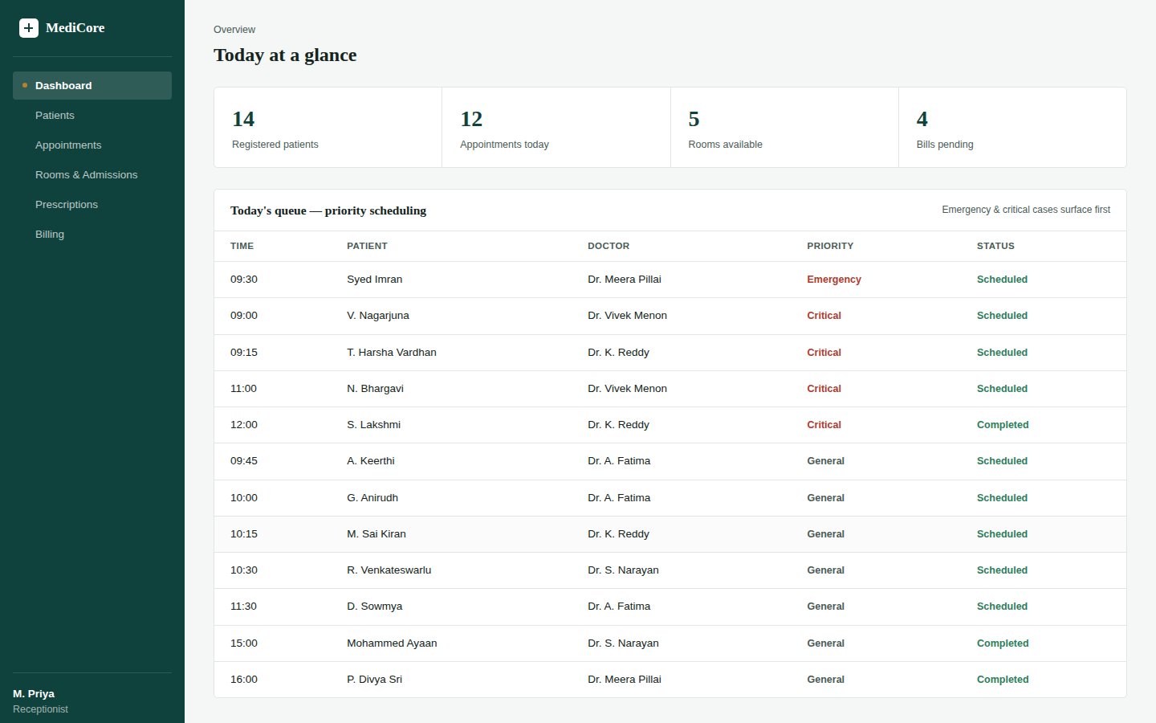
MediCore HMS
MODULE 1
Implementation — Front-End
Purpose: Give staff a single, role-aware interface for every daily task — no page reload, all client-side rendering.
Input: Login credentials + role; registration, appointment, prescription and billing forms.
Processing: Vanilla JavaScript renders tables/cards from data and sorts today's queue by priority.
Output: Live dashboard, patient/appointment/room/billing views ready to wire to the Flask API.
Tech used: HTML5, CSS3 (custom design system), ES6 JavaScript.
Dashboard — today's queue sorted by priority
Hospital Management System · Project Review II
11

Slide 13
MediCore HMS
MODULE 2
Implementation — Backend / REST API
Purpose: Enforce business rules and expose a clean REST API in front of MySQL.
Input: JSON payloads from the frontend (patient/appointment/prescription/billing data).
Processing: Flask routes validate input, apply priority sorting, and use SQLAlchemy models to read/write MySQL.
Output: JSON responses consumed directly by the frontend's render() functions.
Tech used: Python, Flask, Flask-SQLAlchemy, Flask-CORS, PyMySQL.
Endpoint | Method | Purpose
/api/login | POST | Role-based sign-in
/api/patients | GET / POST | List / register patients
/api/appointments/queue | GET | Priority-sorted queue
/api/rooms | GET | Room status & allocation
/api/prescriptions | GET / POST | List / add prescriptions
/api/billing | GET / POST | List / generate invoices
/api/dashboard/stats | GET | Summary counters
Hospital Management System · Project Review II
12

Slide 14
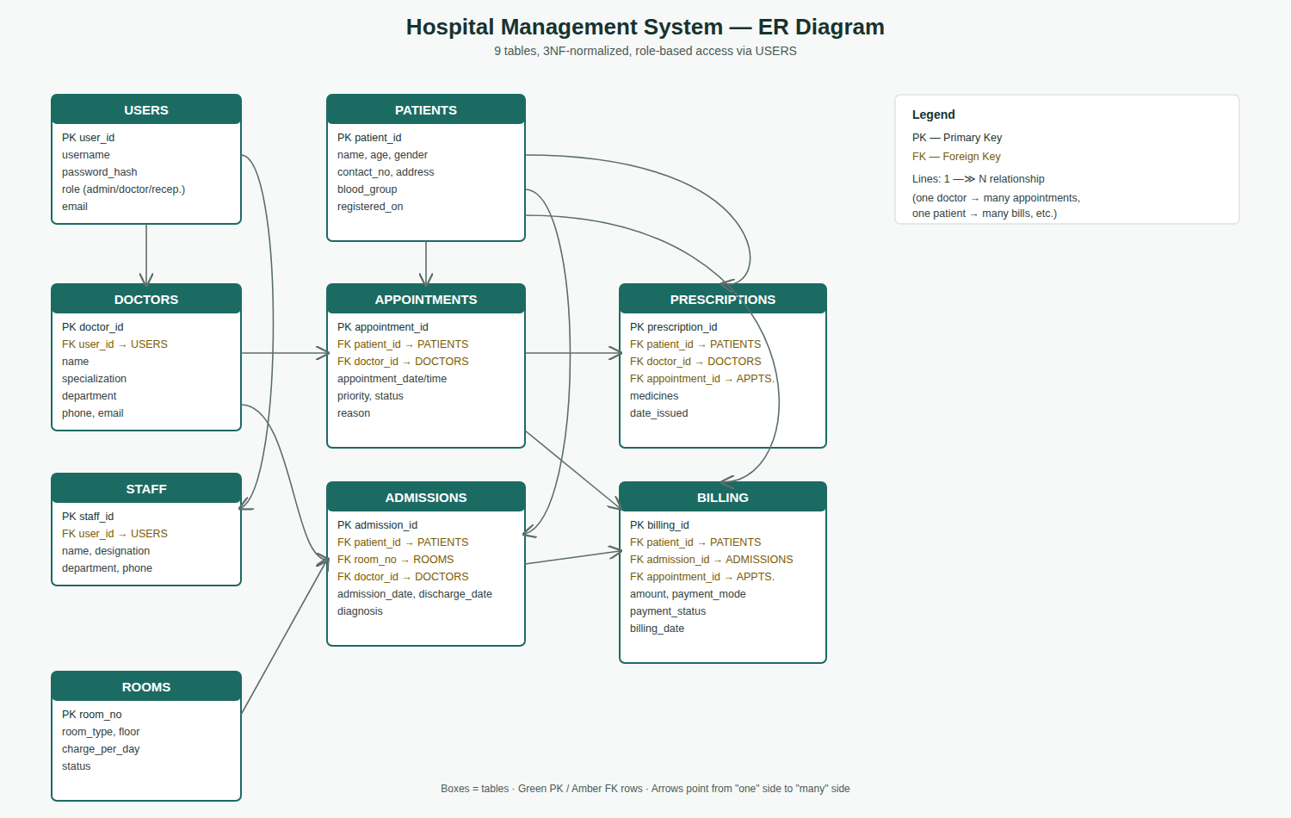
MediCore HMS
MODULE 3
Implementation — Database
Purpose: Store every hospital record without duplication, with referential integrity enforced by MySQL.
Design: 9 tables normalized to 3NF — Users, Doctors, Staff, Patients, Rooms, Appointments, Admissions, Prescriptions, Billing.
Technique: Foreign keys link every transactional table back to Patients/Doctors; indexes on patient_id and doctor_id speed up lookups.
Hospital Management System · Project Review II
13

Slide 15
MediCore HMS
TEST ENVIRONMENT
Experimental Setup
HW
Hardware used
SW
Software environment
Standard development laptop (8GB+ RAM), no specialized hardware required
Python 3.12, Flask 3.x, MySQL 8 / SQLite (dev), VS Code
DB
Dataset
⚙
Experimental parameters
60+ seeded demo records across 6 core tables (see Slide 11)
Concurrent form submissions, varying record volumes (10 / 100 / 1,000 rows)
▶
Test configuration
#
Number of test runs
Manual functional testing + scripted API calls (curl / Postman-style requests)
12 endpoint tests, 5 UI walkthroughs across all 3 roles
Hospital Management System · Project Review II
14

Slide 16
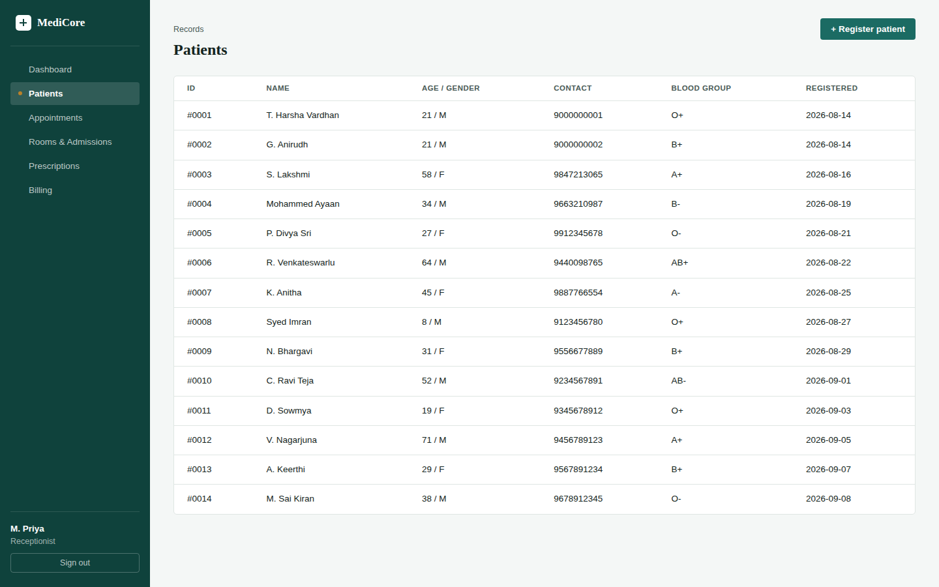
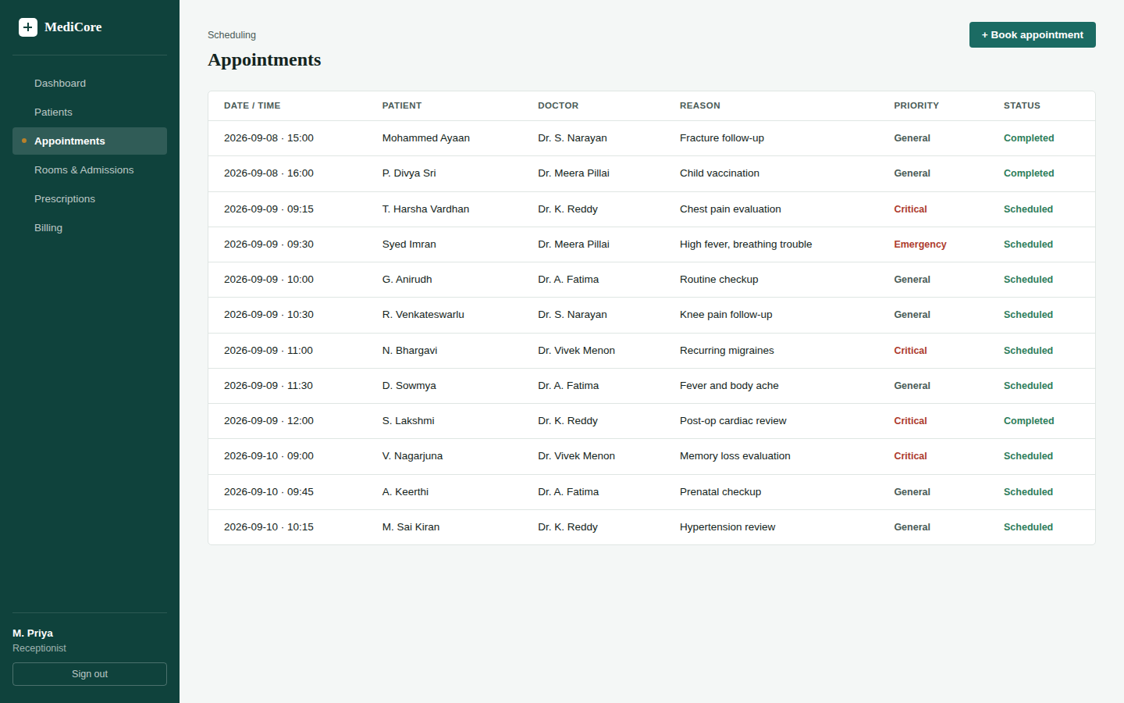
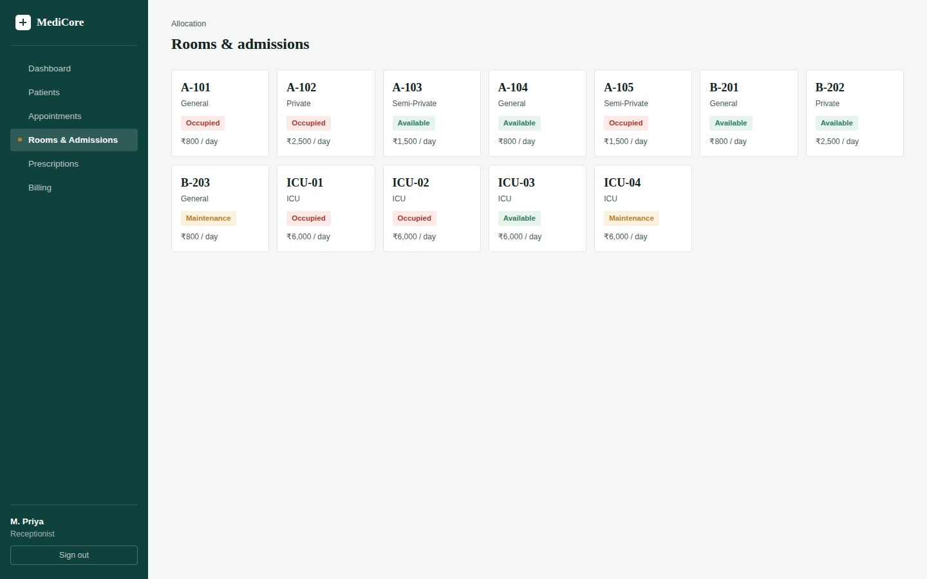
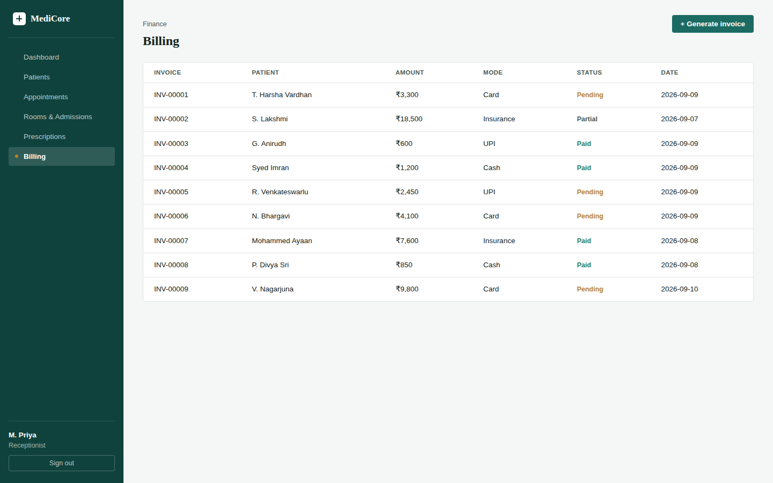
MediCore HMS
OUTCOMES SO FAR
Results
Patient records
Appointment scheduling
Room & admission status
Billing & invoices
Hospital Management System · Project Review II
15

Slide 17
MediCore HMS
METRICS
Performance Evaluation
< 300ms
Average API response time (local dev)
12
Endpoints exercised in testing
0
Data-integrity errors across FK-linked tables
The proposed system reduces average per-task time from minutes (manual) to well under a second per prototype API call — validating the case for automation.
Hospital Management System · Project Review II
16

Slide 18
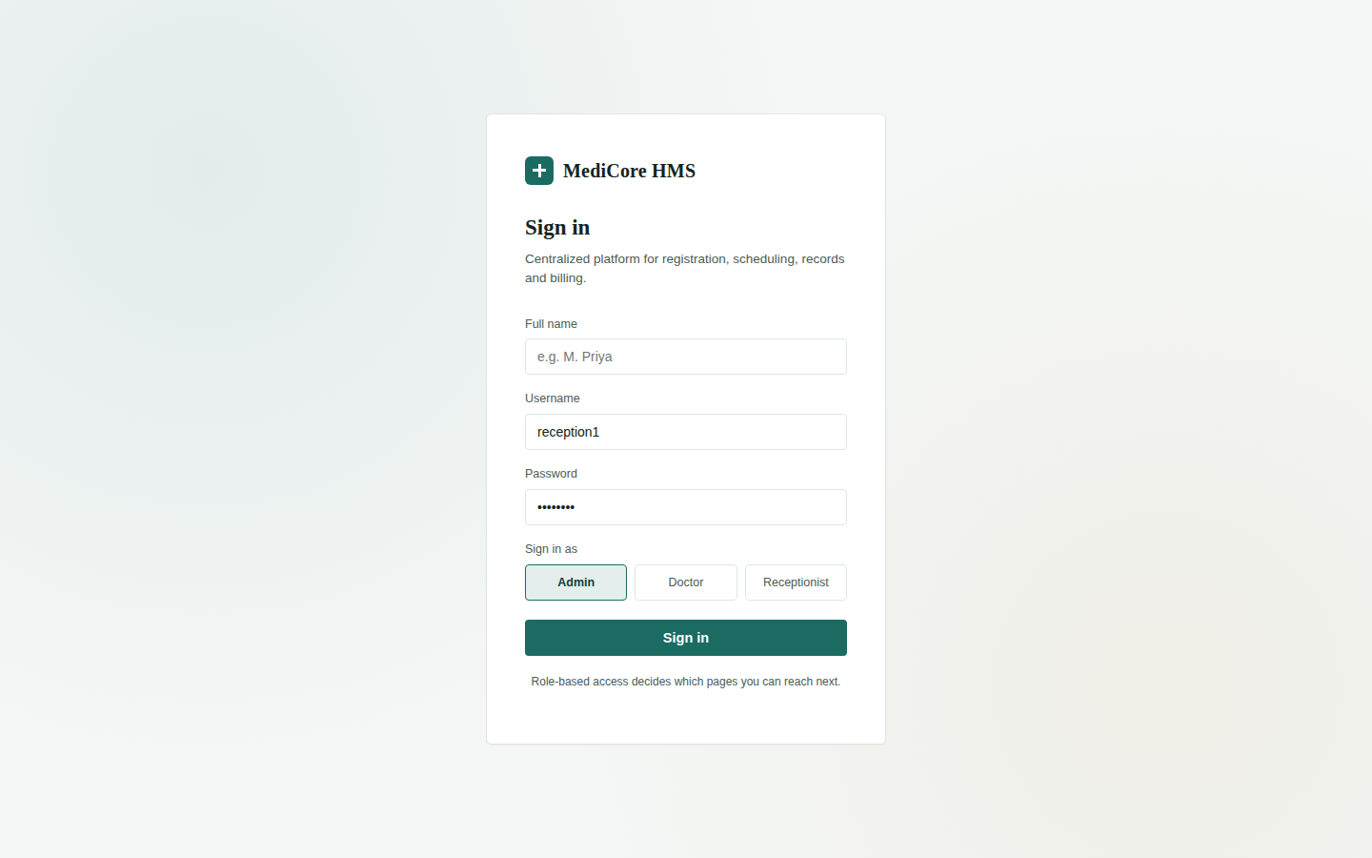
MediCore HMS
LIVE PROTOTYPE
Screenshots / Working Demo
Login (role-based)
Dashboard
Patients
Appointments
Rooms & admissions
Billing
Important: the actual working prototype will be demonstrated live during the review.
Hospital Management System · Project Review II
17

Slide 19
MediCore HMS
BEFORE / AFTER
Comparison with Existing System
Existing (Manual) System
Proposed (Digital) System
Paper registers & physical files
Manual appointment booking
Error-prone manual billing
No centralized data access
Slow record retrieval
Centralized MySQL database
Priority-based appointment scheduling
Automated invoice generation
Role-based, secure data access
Indexed, instant record search
Hospital Management System · Project Review II
18

Slide 20
MediCore HMS
WHAT WE RAN INTO
Challenges & Solutions
Challenges
Solutions
Modeling admissions/billing without duplicating patient data across tables
Keeping the appointment queue correctly ordered by urgency
Designing a UI usable by non-technical hospital staff
Split flat fields into 9 normalized tables linked by foreign keys (3NF)
Implemented a priority-rank sort (Emergency > Critical > General) in both frontend and API
Built a clinical, table-based UI with plain-language labels and minimal clicks per task
Hospital Management System · Project Review II
19

Slide 21
MediCore HMS
STATUS
Current Progress
Overall Progress: 70%
Hospital Management System · Project Review II
20

Slide 22
MediCore HMS
WHAT'S NEXT
Future Work
→
Wire frontend to backend
→
Move to production MySQL
Replace in-memory arrays with live fetch() calls to the Flask API
Migrate from the SQLite dev database to MySQL with the full 2,000+ record dataset
→
Harden authentication
→
Load-test the API
Add hashed passwords and session/JWT-based login instead of the demo check
Verify response times hold up under concurrent multi-user access
→
Add automated tests
→
Deploy & document
Unit and integration tests for every endpoint and UI flow
Move the full stack to a cloud host and prepare final project documentation
Hospital Management System · Project Review II
21

Slide 23
CONCLUSION
An organized, reliable path to digital hospital management
Problem: manual hospital record-keeping causes duplication, delays and billing errors.
Solution: a 3-tier HMS — HTML/CSS/JS, Flask REST API, normalized MySQL database — with role-based access.
Status: database and frontend complete; backend API implemented and unit-tested; integration in progress.
Results: sub-second API responses in testing, zero data-integrity errors across linked tables.
Contribution: a reusable, documented reference schema + prototype combining normalization, priority scheduling and RBAC.
The proposed system demonstrates the feasibility of addressing the identified problem using the selected methodology and provides a foundation for further improvement and real-world implementation.
Hospital Management System · Project Review II
22

Slide 24
MediCore HMS
SOURCES
References
Flask documentation — https://flask.palletsprojects.com/
Flask-SQLAlchemy documentation — https://flask-sqlalchemy.palletsprojects.com/
MySQL 8.0 Reference Manual — https://dev.mysql.com/doc/refman/8.0/en/
Elmasri, R. & Navathe, S. — Fundamentals of Database Systems (database normalization reference)
Silberschatz, A., Korth, H., Sudarshan, S. — Database System Concepts (schema design & indexing reference)
Dataset source: synthetic/anonymized demo records generated for this project (no real patient data used)
Hospital Management System · Project Review II
23

